Slide 1
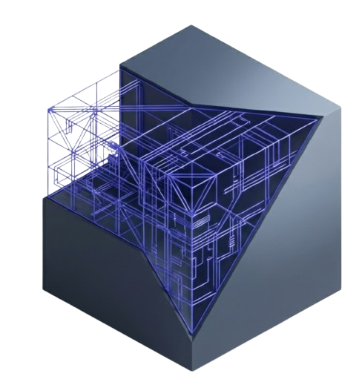
The Hidden Technology
Behind Your Productivity
How AI and Information Technology quietly help us work smarter every day
Jatin Tank | 314

Slide 2
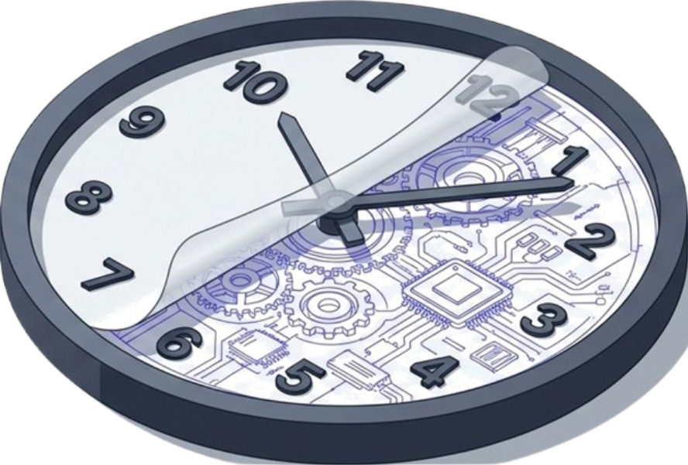
Productivity is Not About
Working Harder
It is about using technology to save time and effort.
Hidden technology boosts efficiency without us realizing it.
Today, we reveal how this invisible architecture improves our daily work.

Slide 3
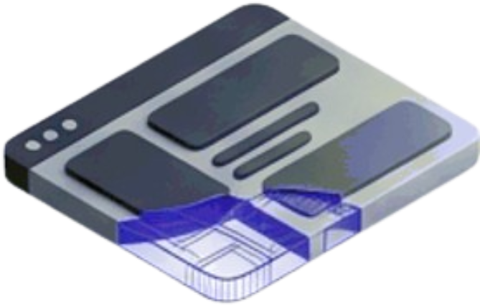
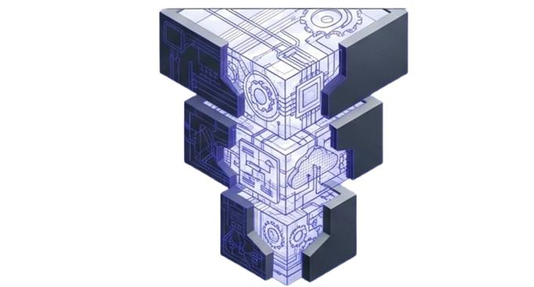
What Hidden Technology?
It works silently in the background.
User Interface
We do not see it, but we rely on it every single day.
The Englne
Cloud Systems
Smart Algorithms

Slide 4
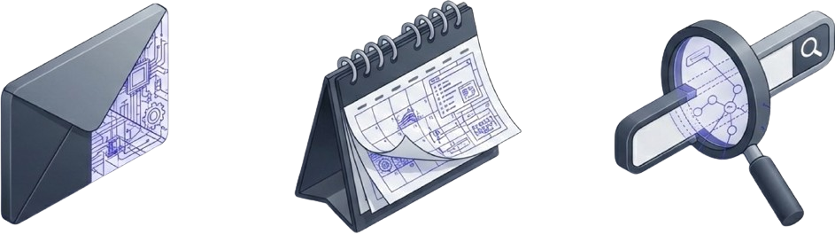
Artificial Intelligence in Daily Life
Filters emails and organizes inboxes.
Sets automated reminders.
Predicts search queries.
We use these tools daily without realizing the complexity behind them.

Slide 5
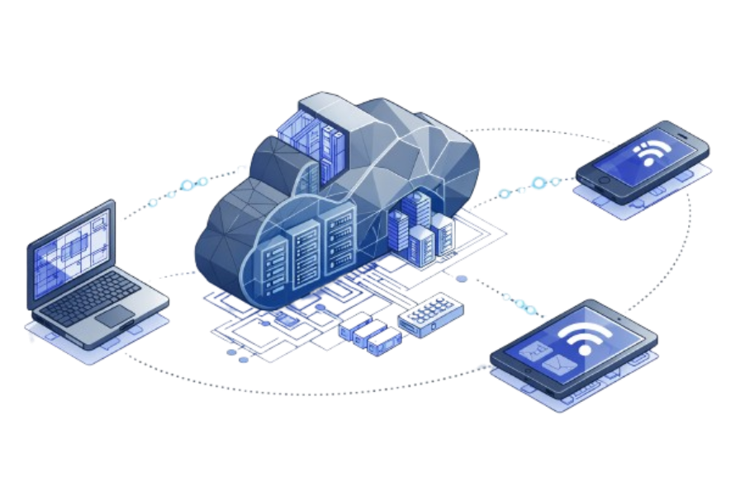
The Power of Cloud Technology
Stores data online for security and scale.
Allows access from anywhere, at any time.
Enables seamless transitions between devices.
Enables seamless transitions between devices.

Slide 6
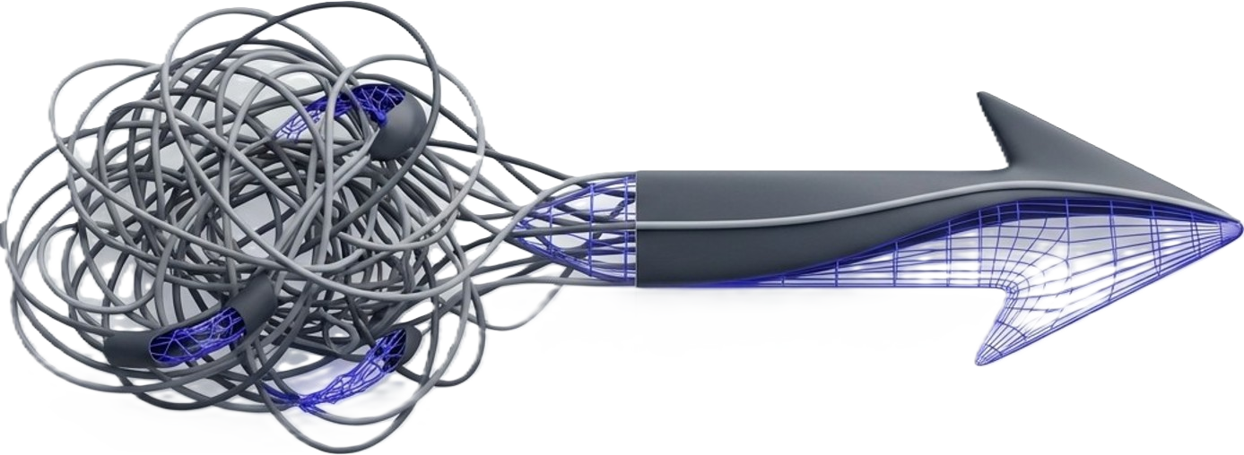
Automation Handles the Repetition
Manual Work
Repetitive tasks are handled without human intervention.
Automated Work
Result: Massive time savings and fewer mistakes.

Slide 7
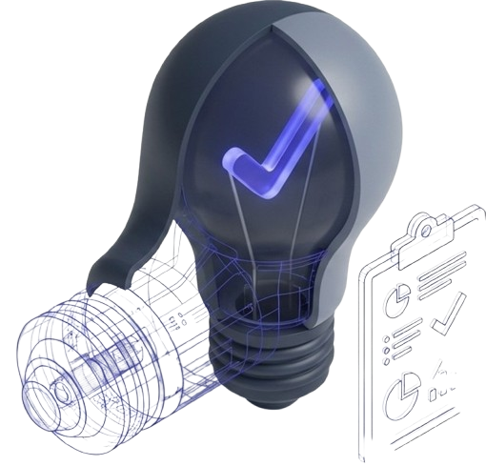
Smart Decision Support
Technology helps us make better, data-driven decisions.
AI analyzes patterns to give suggestions.
Helps us decide faster and smarter.

Slide 8
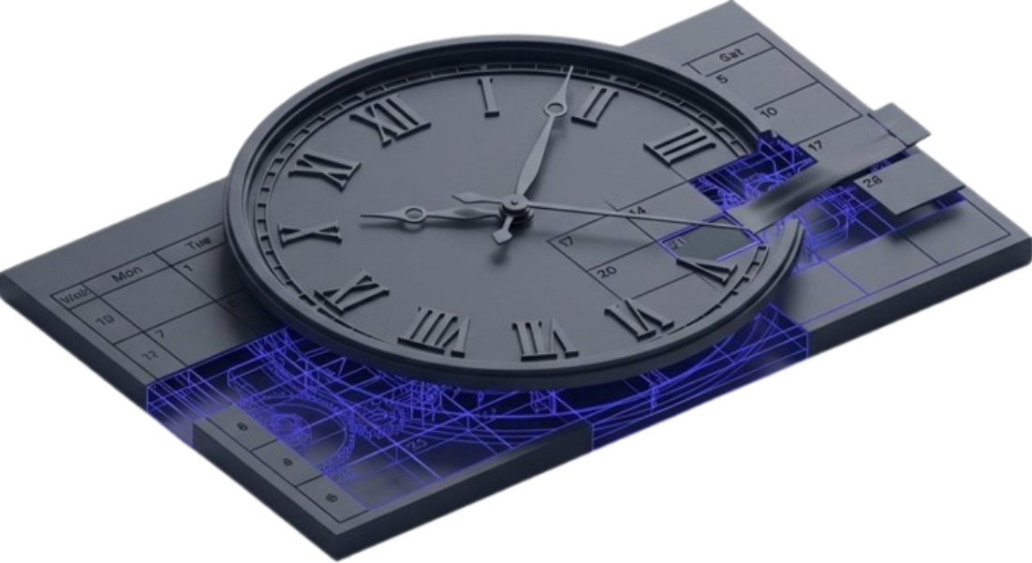
Mastering Time Management
Smart reminders prevent delays.
Balances study, and life,
dynamic calendars
structure the day.

Slide 9
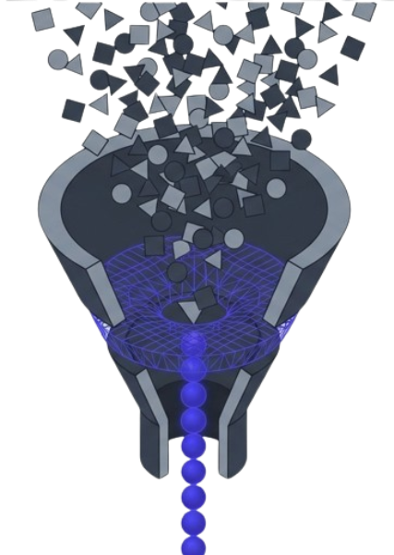
Reducing Information Overload
AllData
AI acts as a filter to summarize important content.
Important Insights

Slide 10
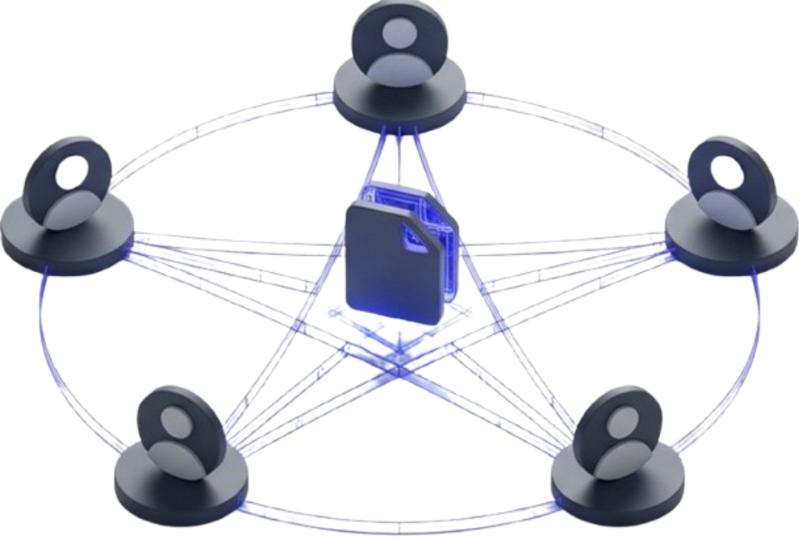
Smart Collaboration
Real-time teamwork across distances.
Multiple people, one file, zero
conflicts.
Reduces errors and eliminates repeated work.

Slide 11
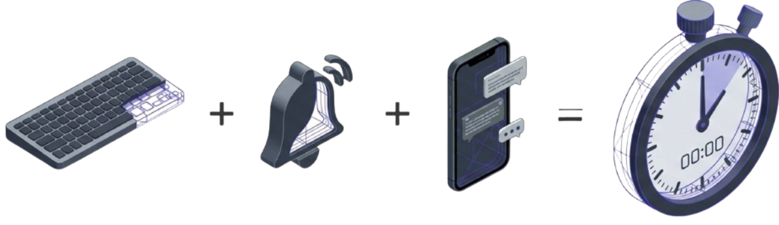
Small Features, Big Impact
Auto-correct, smart replies, and notifications seem minor.
But saving seconds every time adds up to saving hours every week.

Slide 12
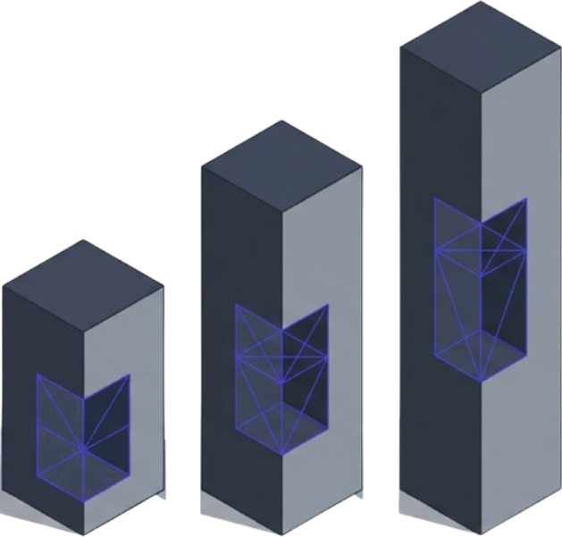
The Benefits Hidden Technology
Efficiency: Saves time and effort.
Quality: Improves accuracy and focus.
Well-being: Supports better work-life balance.
Efficiency
Quality
Well-being

Slide 13
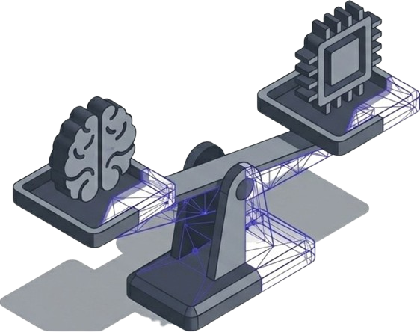
Challenges to Remember
Too much dependency can
reduce critical thinking.
Privacy and data security are paramount.
Goal: Technology should support humans, not replace them.

Slide 14
The Future of Productivity Technology
Technology will become even smarter and faster.
AI may predict tasks before we even plan them.
Work will become more
smooth, simple, and intuitive.

Slide 15
Thank You

